Slide 1
CONCEPT OF IMPLEMENTATION
Implementation means constructing and putting the new system into operation.
Creation of system based on analysis and design document.
Implementation refers to all of the organizational activities working towards the ,
  Adoption,
  Management, and
  Routinization of an innovation.
Implementation activities are needed to transform a newly developed IS into an operational system for end users.

Slide 2
TYPES OF IMPLEMENTAION
FRESH IMPLEMENTATION
REPLACEMENT IMPLEMENTATION
MODIFIED IMPLEMENTAION

Slide 3
IMPLEMENTATION PROCESS
Implementation is a process of
  Coding,
  Testing,
  Installation,
  Documentation,
  Training, and
  Support.
These steps are based on the design specification.
All the requirements of the system, such
as input,
processing, output equipment etc. are provided by design specification.

Slide 4

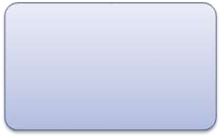







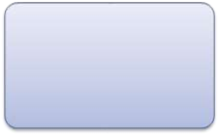
User Training
Planning
Documentation
Acquisition of facilities and space planning
Creating Forms
& Database
Installation /
Conversion
MIS
Organization & Procedure Development
Testing
Acquisition of Hardware & Software
Coding

Slide 5
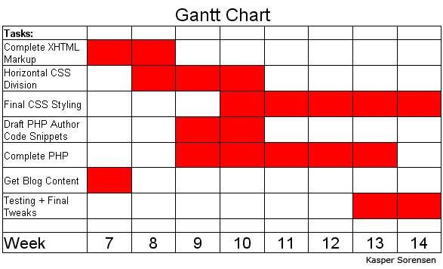
PLANNING THE IMPLEMENTATION
Pre-implementation activity.
Activities required are identified and sequenced accordingly.
Time and cost estimation for each activities are being made.
Plan and implementation schedule are being made by
system various charts, etc.
analyst using
tools like Gantt
network diagrams

Slide 6

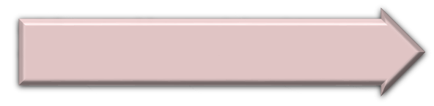

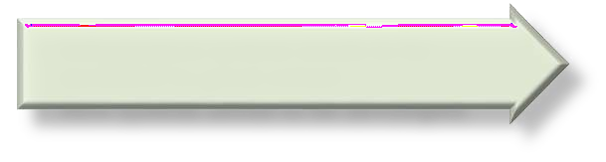
ACQUISITIONS OF FACILITIES AND SPACE PLANNING
The IS to be implemented may be for,
New organization
Where no old system is in existence
New systems are to be implemented
Existing organization
Information system needs to be
modified to great extent
New system needs to be developed
This requires acquisition of facilities like office, computer room, computer library etc.
Proper estimation of floor space requirement and roughs
layouts are to be prepared by MIS manager.

Slide 7
ACQUISITION OF HARDWARE & SOFTWARE
Large business firms or government agencies formalize there hardware and software requirements by listing them in a document called RFP (Request for proposal) or RFQ (Request for quotation).
Business Firms
Vendor
Purchase
Agreement
RFQ

Slide 8
CODING & TESTING
Physical design created by the system designer team are turned into working computer code by the programming team.
Depending on the size and complexity of the system, coding can be an involved, intensive activity.
Immediately after coding process has begun, testing can be started.
System testing involves,
  Testing and debugging software,
  Testing Website performance, and
  Testing new hardware.
It’s important part is, review of prototype of displays,
reports and other output.

Slide 9







DOCUMENTATION
There are 2 types of documentation: -
System Documentation
For maintenance programmers or technical persons
User Documentation
For Users
Detailed information about
Consist of written or other
system’s specification, working functionality
design it’s internal and its
visual information about
an application system,
how it works and how to
use it.

Slide 10




USER TRAINING
Educate and train management, end users, customers, and other business stakeholder.
Proper user training is an important factor in promoting the required culture and thus ensuring the acceptance of new system.
METHODS AND AIDS OF TRAINING: -
Training Programe
Seminars
User Manuals
Help Screens

Slide 11
INSTALLATION / CONVERSION
Installation or changeover is the event of switch-over from the old system to the new system, which takes place after the system is tested and found reliable.
  In new organization, there are no old systems to replace, so for fresh implementation, new developed and tested systems are installed as it is.
  In existing organizations, old systems are replaced with
the new developed systems.
So for replacement implementation, there are 4 conversion methods.

